Slide 1


An Introduction to Statistical Learning with Applications in R Gareth James • Daniela Witten • Trevor Hastie • Robert Tibshirani
Chapter 7: Moving Beyond Linearity
7.4 Regression Splines
7.5 Smoothing Splines
By Jesica S. Rodriguez-Lopez
March 6, 2015

Slide 2
Overview
Standard linear regression
Polynomial regression
Step functions
Basis functions

Slide 3
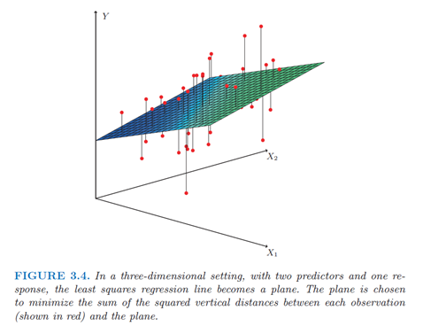

Overview: Standard linear regression
$Y=β_{0}+β_{1}X_{1}+β_{2}X_{2}+…+β_{p}X_{p}+ε$
Least Square: Minimize
$$RSS=\sum_{i=1}^{n}{{\left(y_{i}−{\hat{y}}_{i}\right)}^{2}}$$

Slide 4
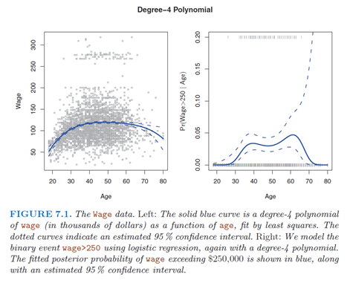

Overview: Polynomial regression
$Y=β_{0}+β_{1}X_{i}+β_{2}X_{i}^{2}+…+β_{d}X_{i}^{d}+ε$
Least Square: Minimize
$$RSS=\sum_{i=1}^{n}{{\left(y_{i}−{\hat{y}}_{i}\right)}^{2}}$$

Slide 5
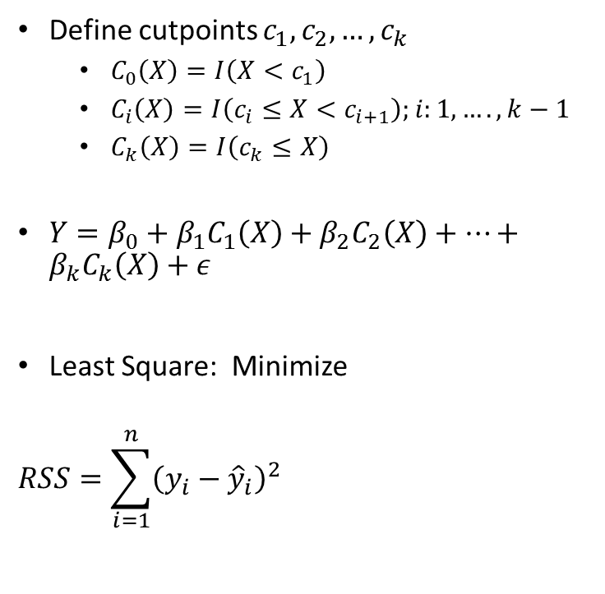
Overview: Step Functions
Define cutpoints $c_{1},c_{2},…,c_{k}$
$C_{0}\left(X\right)=I\left(X<c_{1}\right)$
$C_{i}\left(X\right)=I\left(c_{i}≤X<c_{i+1}\right);i:1,….,k−1$
$C_{k}\left(X\right)=I\left(c_{k}≤X\right)$
$Y=β_{0}+β_{1}C_{1}\left(X\right)+β_{2}C_{2}\left(X\right)+…+β_{k}C_{k}\left(X\right)+ε$
Least Square: Minimize
$$RSS=\sum_{i=1}^{n}{{\left(y_{i}−{\hat{y}}_{i}\right)}^{2}}$$

Slide 6
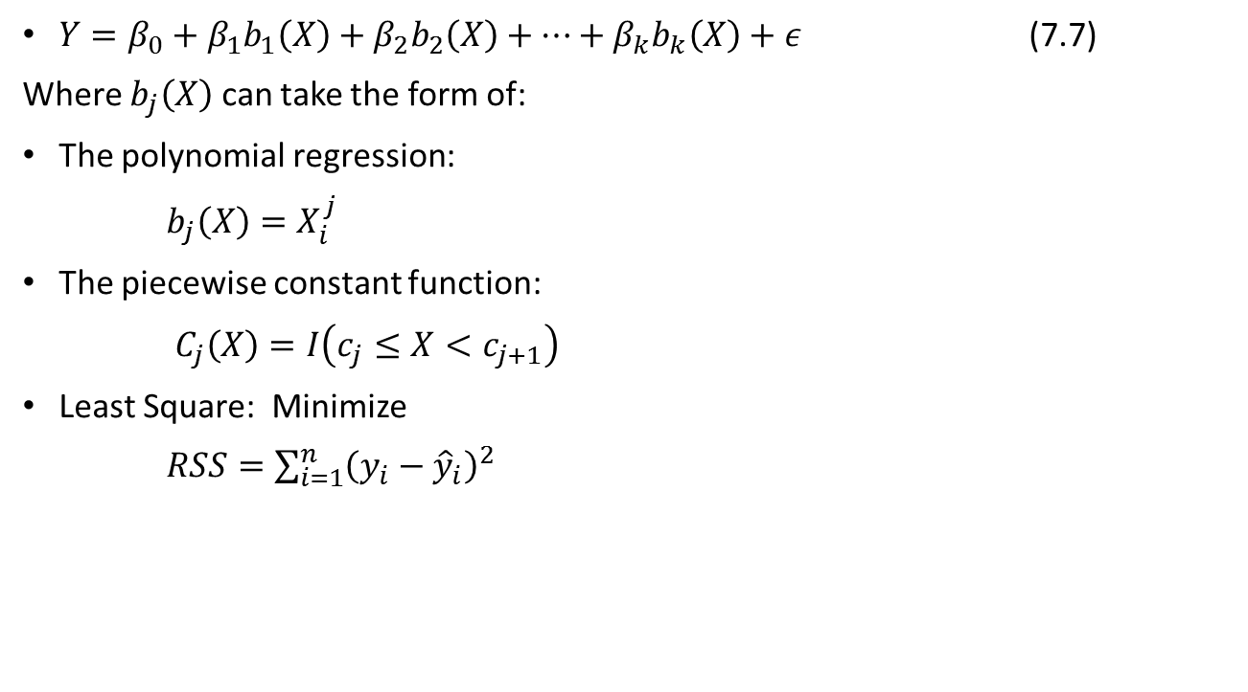
Overview: Basis Functions
$Y=β_{0}+β_{1}b_{1}\left(X\right)+β_{2}b_{2}\left(X\right)+…+β_{k}b_{k}\left(X\right)+ε$ (7.7)
Where $b_{j}\left(X\right)$ can take the form of:
The polynomial regression:
$b_{j}\left(X\right)=X_{i}^{j}$
The piecewise constant function:
$C_{j}\left(X\right)=I\left(c_{j}≤X<c_{j+1}\right)$
Least Square: Minimize
$RSS=\sum_{i=1}^{n}{{\left(y_{i}−{\hat{y}}_{i}\right)}^{2}}$

Slide 7

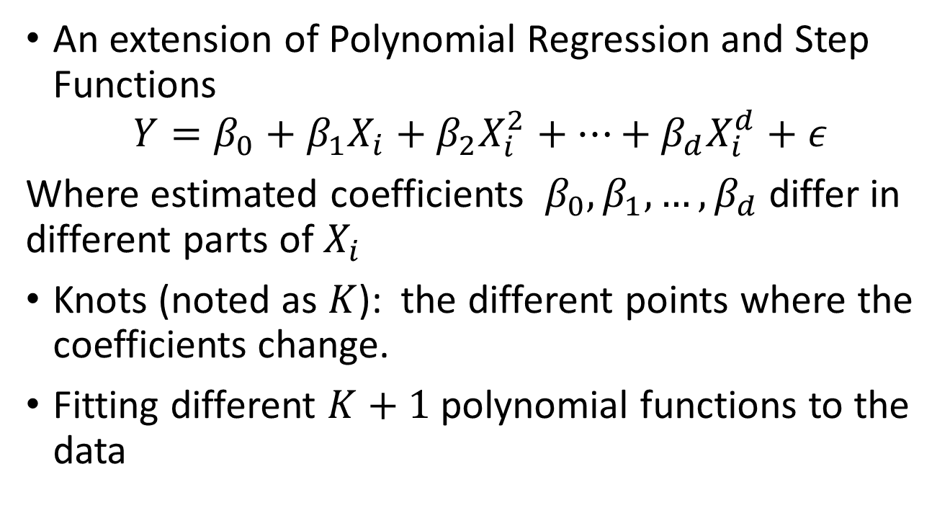
Regression Splines: Piecewise Polynomials
An extension of Polynomial Regression and Step Functions
$$Y=β_{0}+β_{1}X_{i}+β_{2}X_{i}^{2}+…+β_{d}X_{i}^{d}+ε$$
Where estimated coefficients $β_{0},β_{1},…,β_{d}$ differ in different parts of $X_{i}$
Knots (noted as $K$): the different points where the coefficients change.
Fitting different $K+1$polynomial functions to the data
$$K$$

Slide 8
Regression Splines: Constrains and Splines
Cubic, one knot, no constrains (discontinuity in the knot)
Cubic, one knot, one constrain (continuity in the knot)
Cubic, one knot, three constrains (continuity in the knot, and in the first and second derivatives)
Linear, one knot one constrain (continuity in the knot)

Slide 9
Regression Splines: Natural Spline
Natural constrains: Function is linear at the boundary

Slide 10
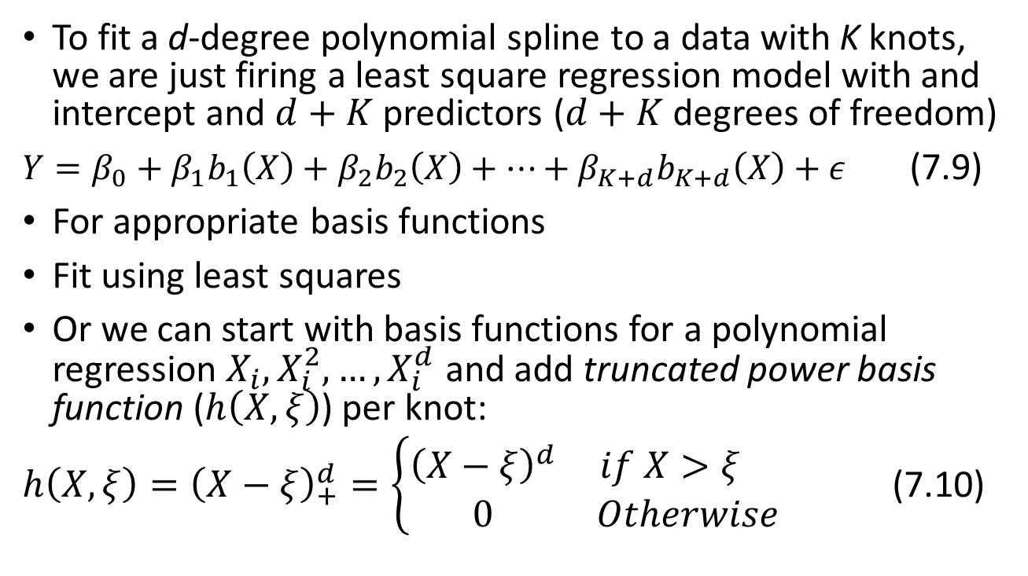
Regression Splines: The Spline Basis Representation
To fit a d-degree polynomial spline to a data with K knots, we are just firing a least square regression model with and intercept and $d+K$ predictors ($d+K$ degrees of freedom)
$Y=β_{0}+β_{1}b_{1}\left(X\right)+β_{2}b_{2}\left(X\right)+…+β_{K+d}b_{K+d}\left(X\right)+ε$ (7.9)
For appropriate basis functions
Fit using least squares
Or we can start with basis functions for a polynomial regression $X_{i}, X_{i}^{2},…, X_{i}^{d}$ and add truncated power basis function ($h\left(X,ξ\right)$) per knot:
$h\left(X,ξ\right)={\left(X−ξ\right)}_{+}^{d}=\left\{\begin{matrix}{\left(X−ξ\right)}^{d} & if X>ξ \\ 0 & Otherwise\end{matrix}\right.$ (7.10)

Slide 11
Regression Splines: The number of knots

Slide 12
Regression Splines: The number of knots
Number of knots translates into degrees of freedom
Regression Spline is most flexible in regions with more knots: polynomial coefficients change more often =>
in theory: more knots where there is more variability
In practice: knots uniformly distribute across values of X
Try different number of those and visually assess the best fit
Cross-validation: the value of K producing the smallest RSS is selected

Slide 13
Regression Splines: The number of knots

Slide 14
Regression Splines Vs. Polynomial Regression
Add flexibility by adding knots instead of a higher polynomial degree.
More knots (flexibility) where the function seems to be more variable.
Natural constrains produces more desirable estimates at the boundaries

Slide 15
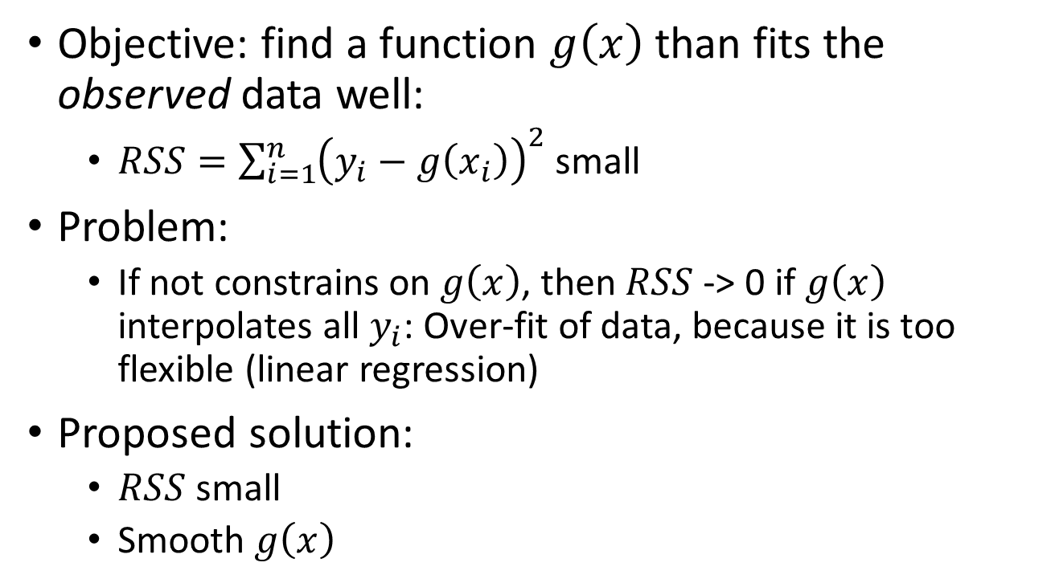
Smoothing Splines: Objective
Objective: find a function $g\left(x\right)$ than fits the observed data well:
$RSS=\sum_{i=1}^{n}{{\left(y_{i}−g\left(x_{i}\right)\right)}^{2}}$ small
Problem:
If not constrains on $g\left(x\right)$, then $RSS$ -> 0 if $g\left(x\right)$ interpolates all $y_{i}$: Over-fit of data, because it is too flexible (linear regression)
Proposed solution:
$RSS$ small
Smooth $g\left(x\right)$

Slide 16
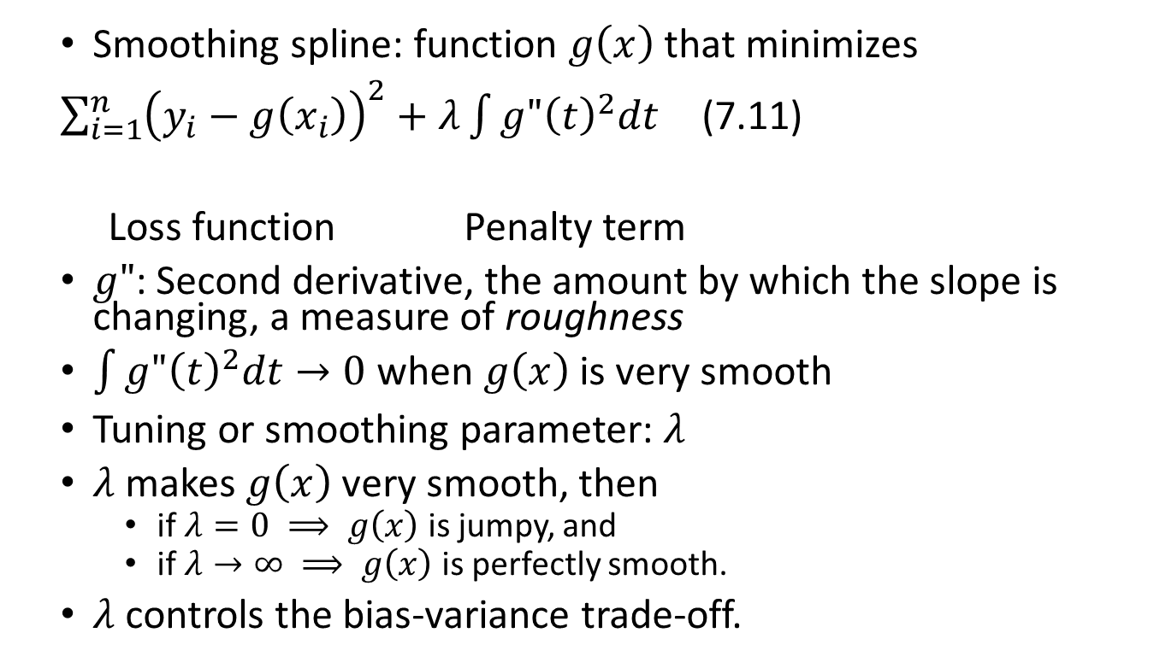
Smoothing Splines: Definitions
Smoothing spline: function $g\left(x\right)$ that minimizes
$\sum_{i=1}^{n}{{\left(y_{i}−g\left(x_{i}\right)\right)}^{2}}+λ\int{{g"\left(t\right)}^{2}dt}$ (7.11)
Loss function Penalty term
$g"$: Second derivative, the amount by which the slope is changing, a measure of roughness
$\int{{g"\left(t\right)}^{2}dt}→0$ when $g\left(x\right)$ is very smooth
Tuning or smoothing parameter: $λ$
$λ$ makes $g\left(x\right)$ very smooth, then
if $λ=0 ⟹ g\left(x\right)$ is jumpy, and
if $λ→∞ ⟹ g\left(x\right)$ is perfectly smooth.
$λ$ controls the bias-variance trade-off.

Slide 17
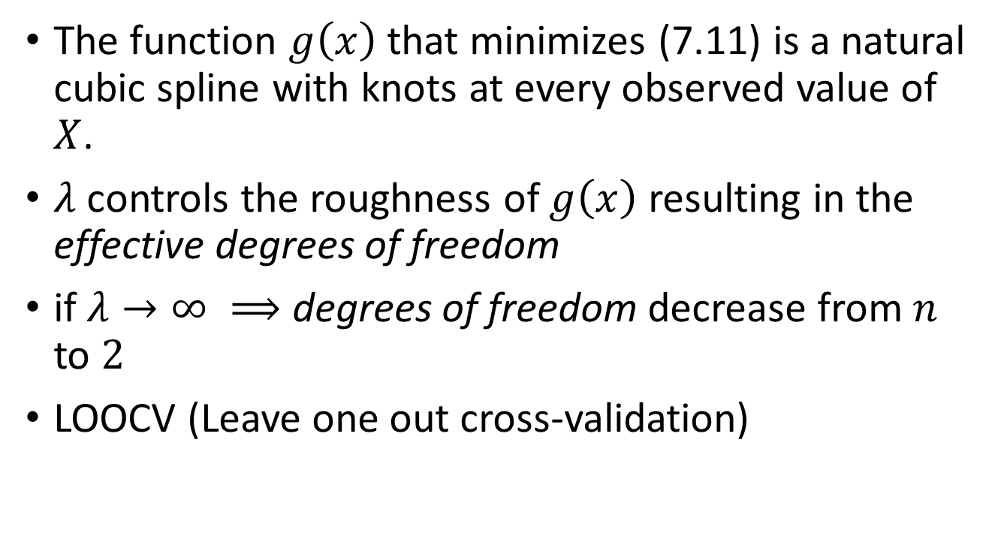
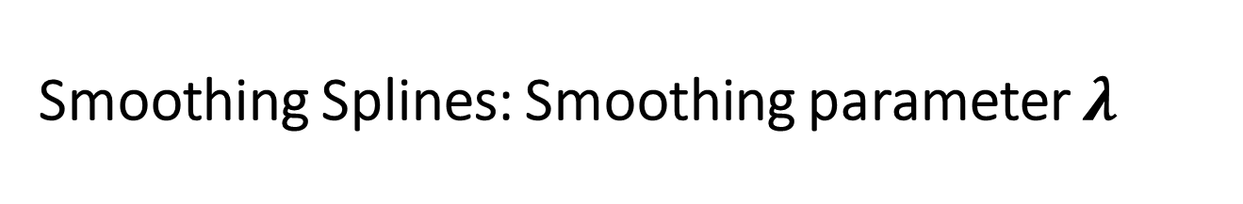
Smoothing Splines: Smoothing parameter $λ$
The function $g\left(x\right)$ that minimizes (7.11) is a natural cubic spline with knots at every observed value of $X$.
$λ$ controls the roughness of $g\left(x\right)$ resulting in the effective degrees of freedom
if $λ→∞ ⟹$ degrees of freedom decrease from $n$ to $2$
LOOCV (Leave one out cross-validation)

Slide 18
Smoothing Splines: Smoothing parameter $λ$

